Slide 1

Analytical Characterization and Design Space Exploration for Optimization of CNNs
Rui Li, Yufan Xu, Aravind Sukumaran-Rajam, Atanas Rountev, P. Sadayappan
Notes:
click to next page

Slide 2
Contents
Motivation
Existing work
System overview
Modeling data volume
Strength of analytical pruning
High-performance code generation
Experiment evaluation
Notes:
our presentation includes:
...
click to next page

Slide 3
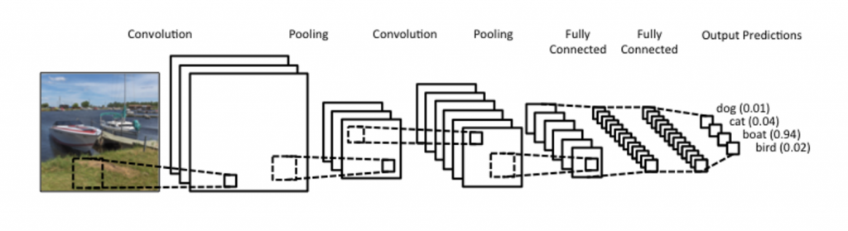
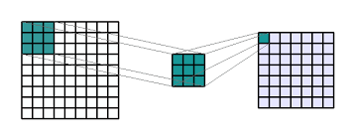
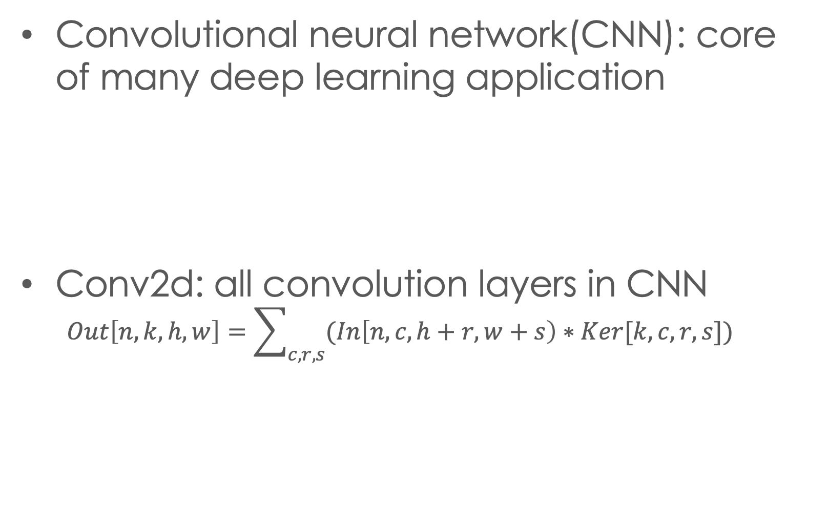
Motivation
Convolutional neural network(CNN): core of many deep learning application
Conv2d: all convolution layers in CNN
$$Out\left[n,k,h,w\right]=\sum_{c,r,s}{(In\left[n,c,h+r,w+s\right)∗Ker[k,c,r,s}])$$
Notes:
Our paper is focusing on optimizing..
...
Based on that we can quickly write a simple implemetaion of conv2d ( show code ), and we will demonstrate why it is not recommend to use this un-opt version

Slide 4
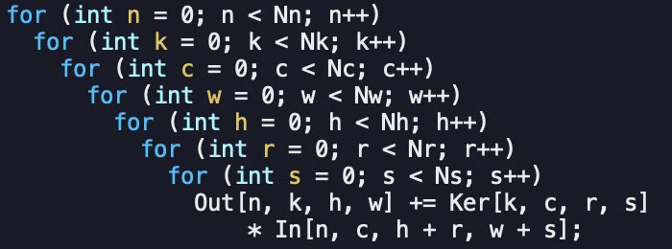
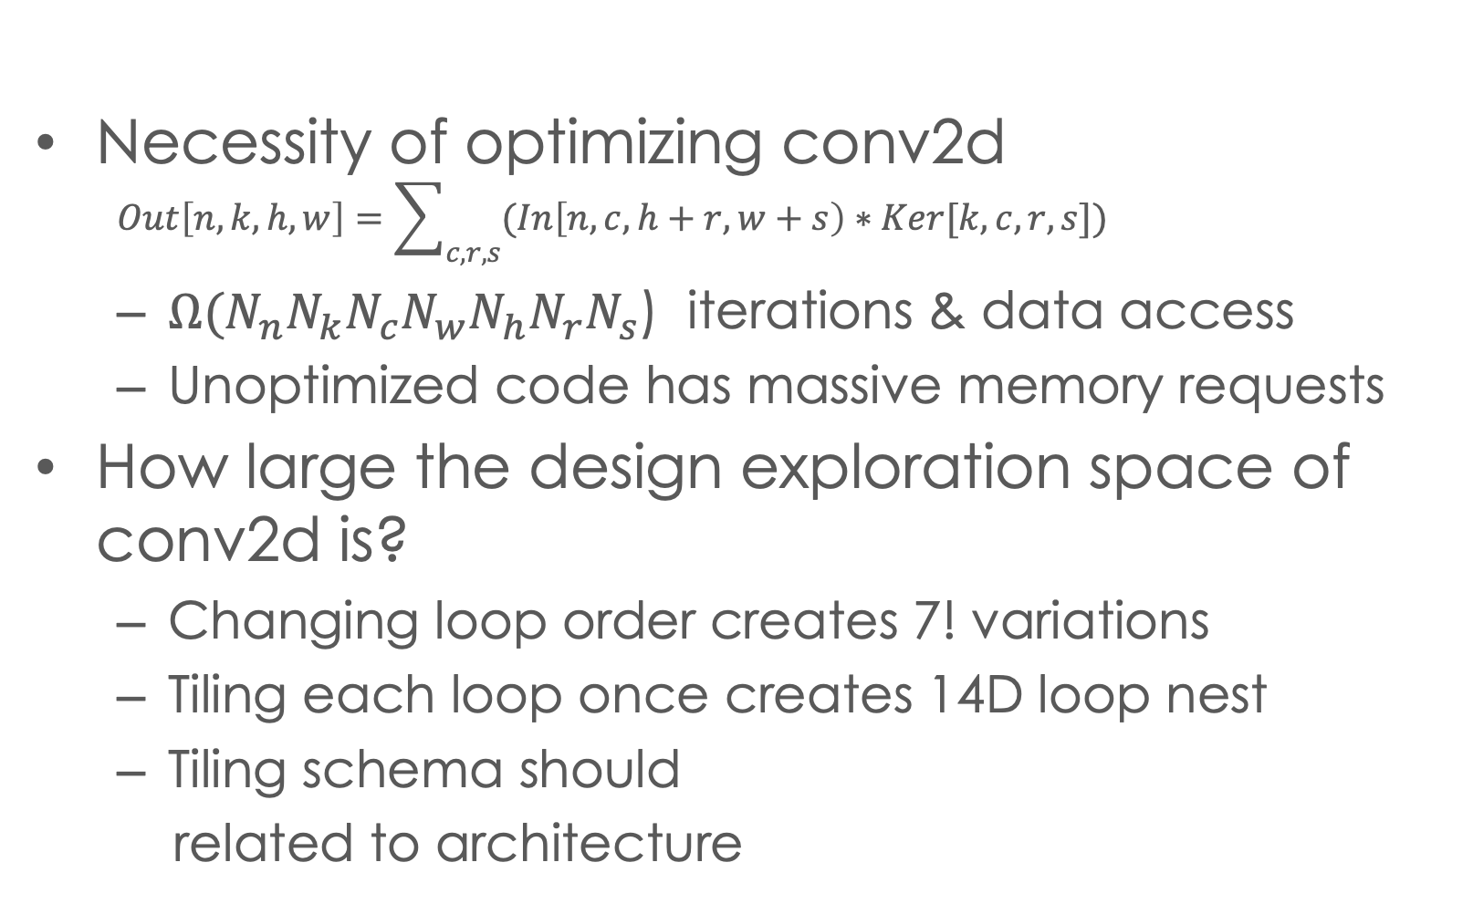
Motivation
Necessity of optimizing conv2d
$$Out\left[n,k,h,w\right]=\sum_{c,r,s}{(In\left[n,c,h+r,w+s\right)∗Ker[k,c,r,s}])$$
${Ω(N}_{n}N_{k}N_{c}N_{w}N_{h}N_{r}N_{s}$) iterations & data access
Unoptimized code has massive memory requests
How large the design exploration space of conv2d is?
Changing loop order creates 7! variations
Tiling each loop once creates 14D loop nest
Tiling schema should
related to architecture
Notes:
( and we'll demon why not recommend this unopt ver)
the 7-d loop creates massive..
..
Now, to find a way to optimize this code, an important qeustion is: how large is the design space of the opti..
we consider 2 tech
1. repermu, 2. tiling
howver this is not enough, because the loop tiling structure should match the arch
We will use an example to show the full design space of 2-lv-cache.

Slide 5
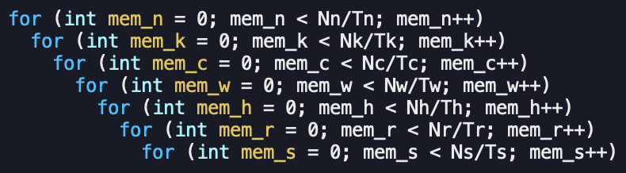
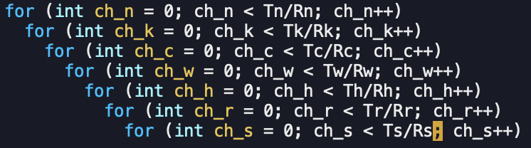
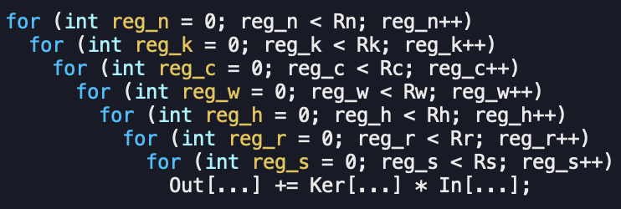
Motivation
Design space exploration of 2-level hierarchy
Memory
7! Permutations
7 tile-size vars
Data movement
Loop order & tile-sizes decide data movement volume between memory and cache
Cache
7! Permutations
7 tile-size vars
Data movement
Loop order & tile-sizes decide data movement volume between cache and register
register
Notes:
we have 2 lv cache, named, 1 lv mem.
for each lv we create..
go top to bottom
data covers.., # permus, # vars
register lv- nopermu because
conclude 2lv
generalize this to get description of main challenge

Slide 6
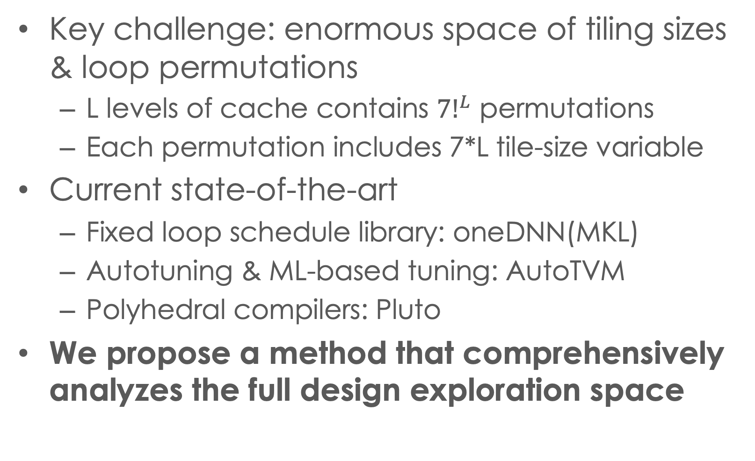
Existing work
Key challenge: enormous space of tiling sizes & loop permutations
L levels of cache contains ${7!}^{L}$ permutations
Each permutation includes 7*L tile-size variable
Current state-of-the-art
Fixed loop schedule library: oneDNN(MKL)
Autotuning & ML-based tuning: AutoTVM
Polyhedral compilers: Pluto
We propose a method that comprehensively analyzes the full design exploration space
Notes:
...
We'll intro our work by first provide an overview

Slide 7
System overview
Stage 1: Modeling & pruning
Modeling data volume in analytical expression
Pruning to eliminate design space explosion
Stage 2: Solving machinery
Find the solution of the modelled problem
Stage 3: Code generation
Parallelism, SIMD, etc.
Notes:
our can be summarized as 3 stage
..
we will starts from intro our statg 1

Slide 8
data volume Modle: Matmul example
Spill out
Tk
Not in cache, reload
Atile
Atile
Ctile
A
C
Ti
Ctile
For oi = 0:Ni:Ti
For oj = 0:Nj:Tj
For ok = 0:Nk:Tk
For pi = 0:Ti:1
For pj = 0:Tj:1
For pk = 0:Tk:1
C[oi+pi, oj+pj] +=
A[oi+pi, ok+pk]*
B[oj+pj, ok+pk];
Atile
Atile
Ctile
Ctile
i
Dv==TiTj+TiNk+TjNk
Dv=NiNj+NiNk*Nj/Tj+NjNk*Ni/Ti
k
Tj
j
B
Btile
Btile
Tk
k
Not in cache, reload
Dv=TiNj+TiNk*Nj/Tj+NjNk
Dv=TiTj+TiTk+TjTk
Btile
Btile
Spill out
Ni, Nj, Nk larger than cache capacity
Notes:
we use a matmul example to demo
left is, right is , assumption is
we start analysis from point loops
...
We can apply this idea to conv2d op

Slide 9


Pruning volume expression
Applying previous idea to conv2d
Loop order (outer to inner): kt,ct,rt,st,nt,ht,wt
Volume = ${\frac{N_{k}N_{c}N_{r}N_{s}}{T_{k}T_{c}T_{r}T_{s}}\frac{N_{n}N_{h}}{T_{n}T_{h}}T}_{n}T_{c}\left(T_{h}+T_{r}−1\right)\left(N_{w}+T_{s}−1\right)+\frac{N_{k}N_{c}N_{r}N_{s}}{T_{k}T_{c}T_{r}T_{s}}∗T_{k}T_{c}T_{r}T_{s}+\frac{N_{k}N_{c}N_{r}N_{s}}{T_{k}T_{c}T_{r}T_{s}}\frac{N_{n}N_{h}}{T_{n}T_{h}}\frac{N_{w}}{T_{w}}T_{n}T_{k}T_{h}T_{w}$
Loop order (outer to inner): kt,ct,rt,st,wt,ht,nt
Volume = ${\frac{N_{k}N_{c}N_{r}N_{s}}{T_{k}T_{c}T_{r}T_{s}}\frac{N_{n}N_{w}N_{h}}{T_{n}T_{w}T_{h}}T}_{n}T_{c}\left(T_{h}+T_{r}−1\right)\left(T_{w}+T_{s}−1\right)+\frac{N_{k}N_{c}N_{r}N_{s}}{T_{k}T_{c}T_{r}T_{s}}∗T_{k}T_{c}T_{r}T_{s}+\frac{N_{k}N_{c}N_{r}N_{s}}{T_{k}T_{c}T_{r}T_{s}}\frac{N_{n}N_{h}}{T_{n}T_{h}}\frac{N_{w}}{T_{w}}T_{n}T_{k}T_{h}T_{w}$
Loop order < kt,ct,rt,st,nt,ht,wt >
is always better than < kt,ct,rt,st,wt,ht,nt >
$$\left(N_{w}+T_{s}−1\right)≤\frac{N_{w}}{T_{w}}(T_{w}+T_{s}−1)$$
Notes:
for a given loop permu, we can infer.
for another... we can also
now if we compare these 2 expr
...
we further simplif the compariosn and obtain..
..
By use this tech, we conclude that

Slide 10
Pruning results
All 7! permutations cannot be better than the following 8 equivalent classes of permutations
⟨{kt, ct, rt, st }, {nt, ht }, wt⟩
⟨{nt, kt, ht, wt }, {ct,rt }, st⟩
⟨{nt,ct, ht, rt, st }, wt, kt⟩
⟨{nt,ct, ht, wt, rt }, st, kt⟩
⟨{kt, ct, rt, st }, {nt, wt }, ht⟩
⟨{nt, kt, ht, wt }, {ct, st }, rt⟩
⟨{nt, ct, wt, rt, st }, ht, kt⟩
⟨{nt, ct, ht, wt, st },rt, kt⟩
(from left to right is from outer loop to inner)
Repermute loop order inside curly brackets does not change data volume expression
Notes:
we need to mention in our slides, the curly bracket indicates repermuting iterators inside
Till here we have demon ..
we will move to how to formalize the optimization problem using the model and how to solve it

Slide 11
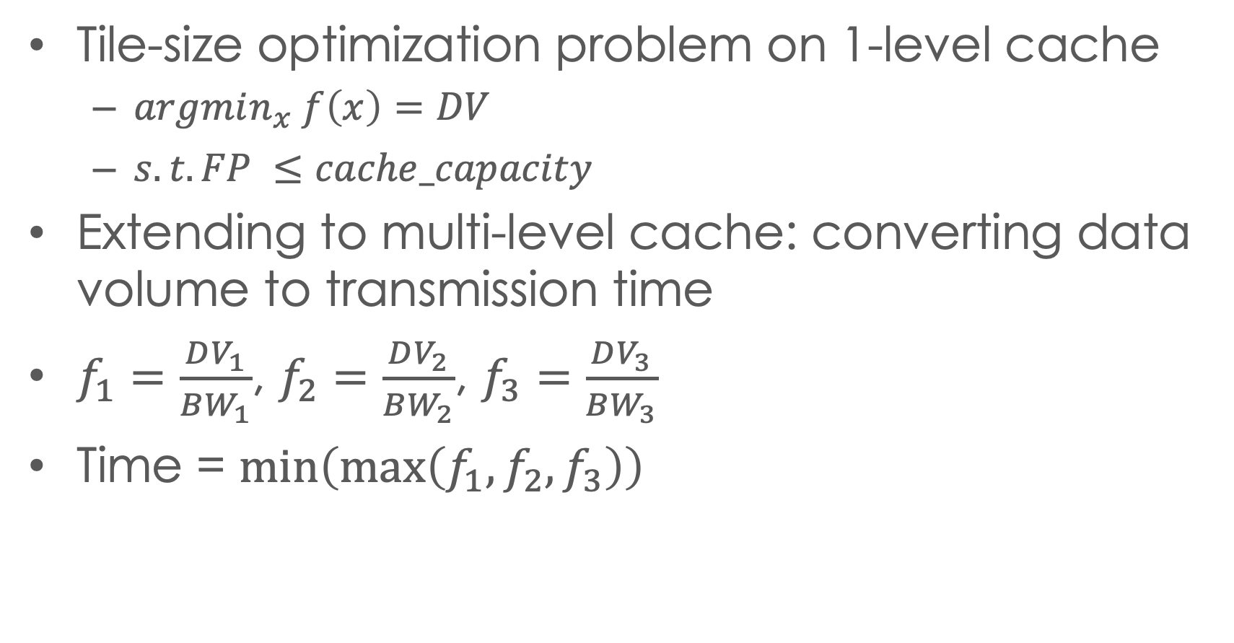
Solving machinery
Tile-size optimization problem on 1-level cache
$argmin_{x} f\left(x\right)=DV$
$s.t. FP ≤cache_capacity$
Extending to multi-level cache: converting data volume to transmission time
$f_{1}=\frac{DV_{1}}{BW_{1}}$, $f_{2}=\frac{DV_{2}}{BW_{2}}$, $f_{3}=\frac{DV_{3}}{BW_{3}}$
Time = $\min\left(\max\left(f_{1},f_{2},f_{3}\right)\right)$
Notes:
we can plot those f to get better view.
the perf of system is always limited by the slowest component.
We will then move to the nxet stage to briefly discuss how to codegen

Slide 12
Code generation
L2 tile
L2 tile
Shared-memory parallelism
Divide the shared-cache
Apply time-based modeling
micro-kernel
guarantees instruction-level optimization
Emits assembly code to avoid unexpected compiler interference
Time L3 to L2
L3 tile
Per-core L3 tile
Per-core L3 tile
Time memory to L3
memory
Notes:
there are sveral important factors, 1. parallel 2. use microkenerl to ensure the inst lv perf

Slide 13
Experiment Overview
Benchmarks:
conv2d from ResNet, MobileNet, and Yolo-9000
32 conv2ds in different shapes
Platforms:
8-cores i7-9700K with AVX2,
18-cores i9-10980XE with AVX512
Performance comparison
oneDNN: high-optimized library
AutoTVM: ML-based autotuning compiler
Mopt-1: best implementation found by model
Mopt-5: actual best implementation among the top-5 found by model

Slide 14
Experiment: performance comparison
Parallel conv2d performance comparison on Intel 8-core i7-9700K
Parallel conv2d performance comparison on Intel 18-core i9-10980XE

Slide 15
conclusion
We proposed a new approach to find the best configuration for optimizing conv2d
We created an effective analytical modeling approach which is exploited to achieve dramatic space pruning
We demonstrate that achieved performance can be comparable to or better than state-of-the-art
Acknowledgments: This work was supported in part by the U.S. National Science Foundation through awards 1946752, 1919122 and 2018016.

Slide 16
Thanks for listening
Questions ?

